Slide 1

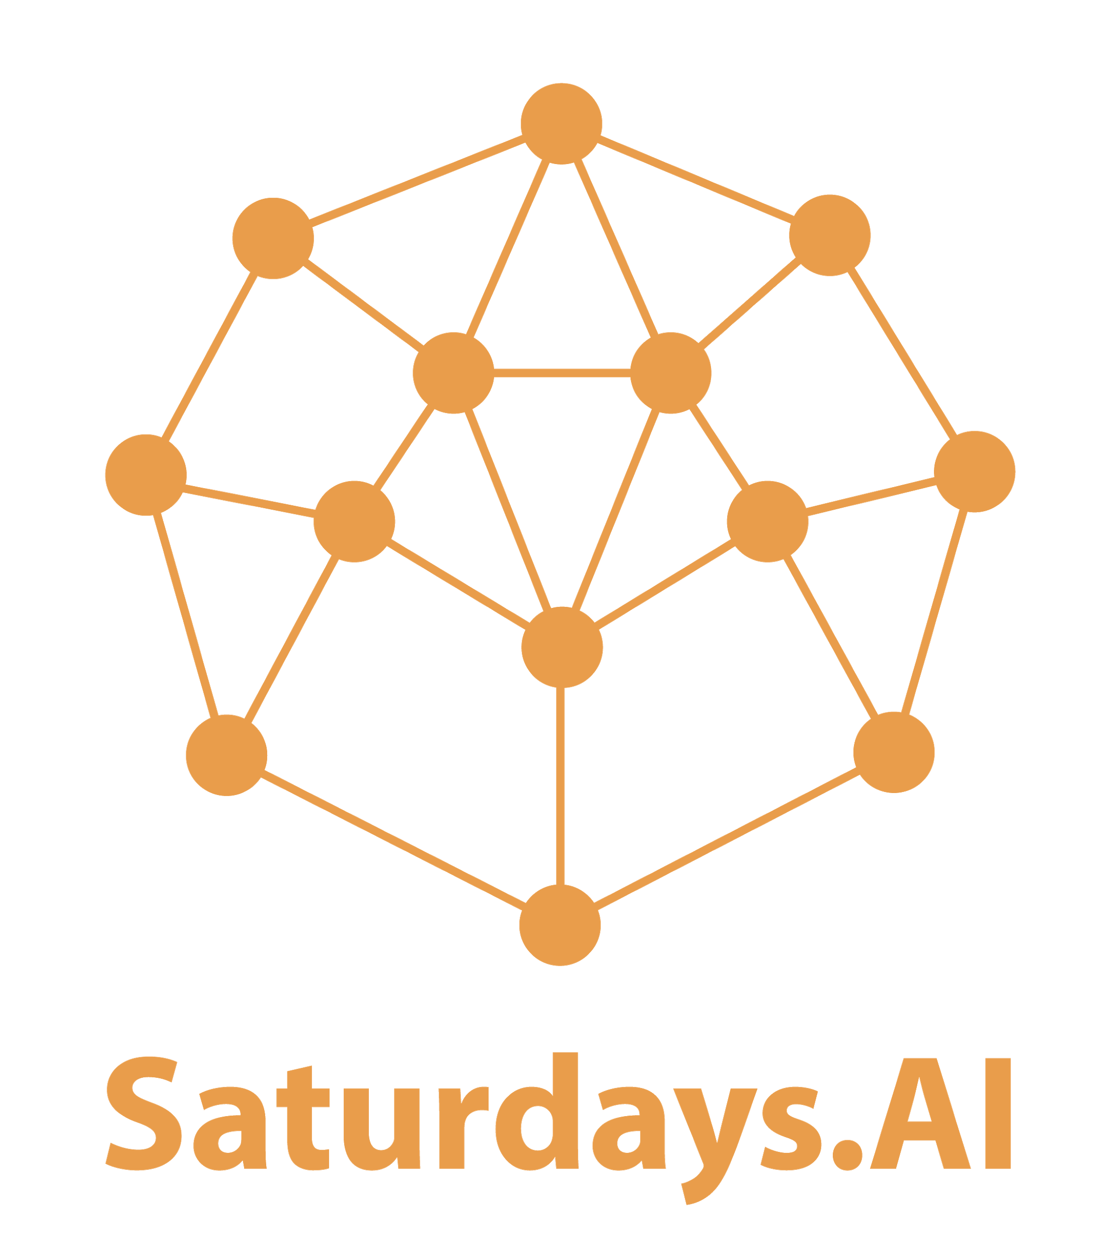
#1 Neural Networks: Basics
by Saturdays.AI
Saturdays.AI
Deep Learning

Slide 2

Week 1
Schedule
State of the course
Session 1 Review
Challenge
Notebook + resources

Slide 3
State of the course
#1 Classification & Main components🔴 Today!
#2 Convolutional Neural Networks 🔜
#3 Object detection & Image segmentation
#4 Autoencoders
#5 Reinforcement Learning
#6 Deep Learning 4 NLP
Notes:
Neural Networks
Convolutional Neural Networks + Transfer Learning
Object detection & image segmentation
Autoencoders + Unsupervised Learning
Reinforcement Learning
NLP + Transformers

Slide 4
Neural Networks
Introduction
Deep Learning
Activation functions
Gradient Descent
Optimizers
Keras & Your first NN!

Slide 5

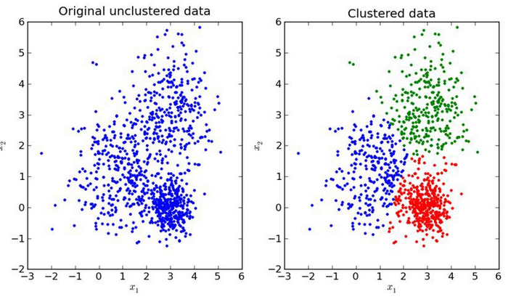
ML Algorithms
Supervised Learning
Unsupervised Learning

Slide 6

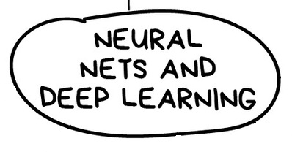
ML Algorithms

Slide 7
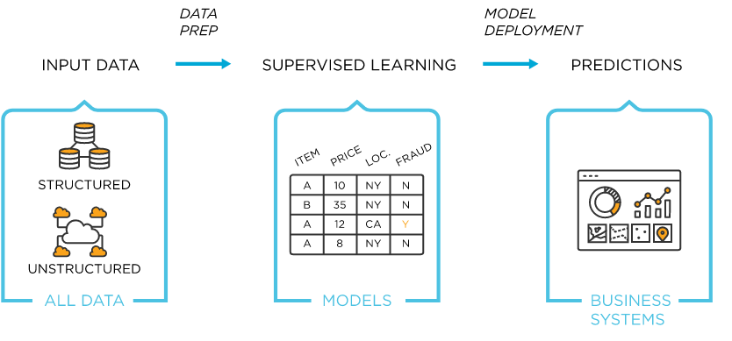
Why change the current method?

Slide 8

Why change the current method?

Slide 9
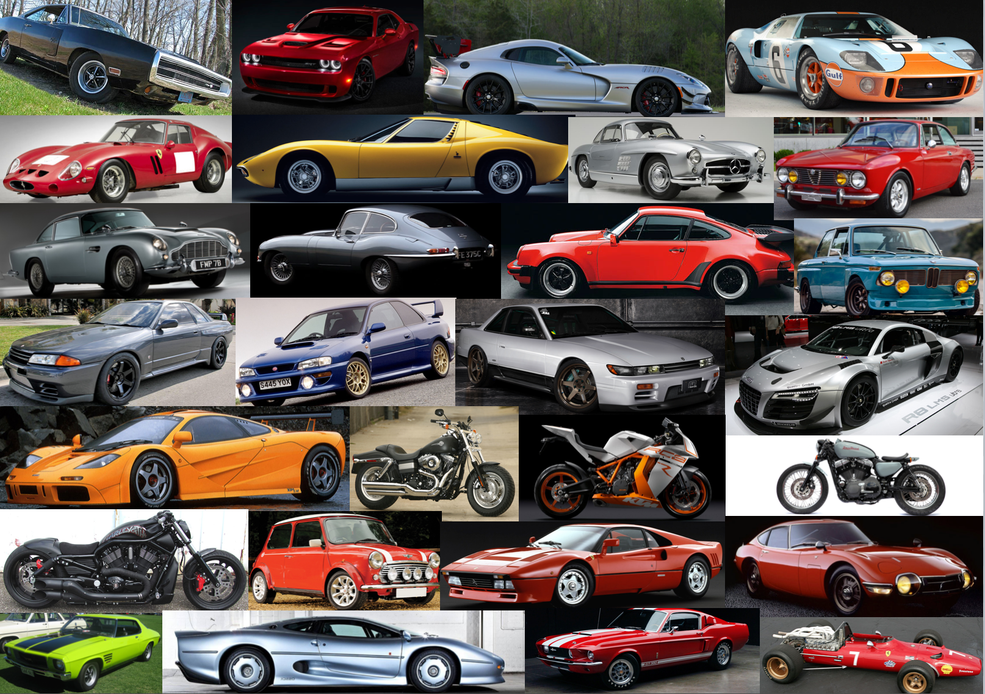
Why change the current method?

Slide 10
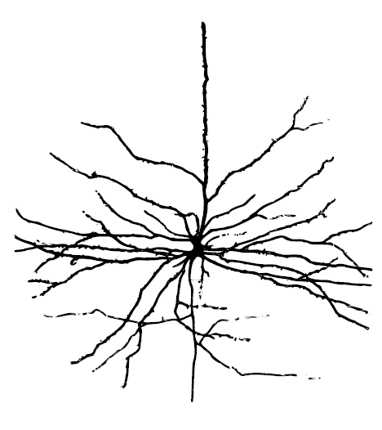
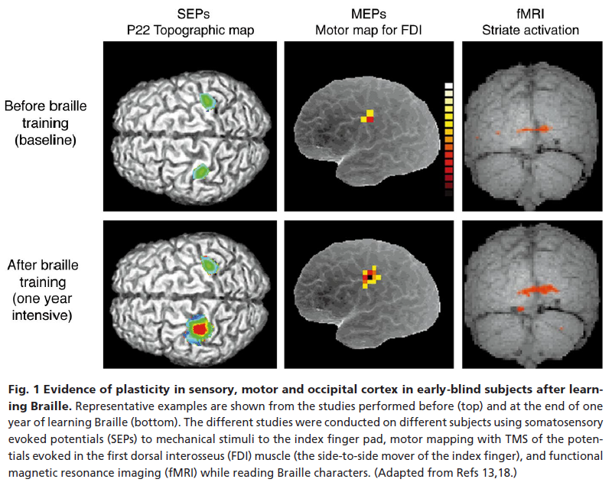
The Neuron
Hebbian Learning
Neuroplasticity

Slide 11
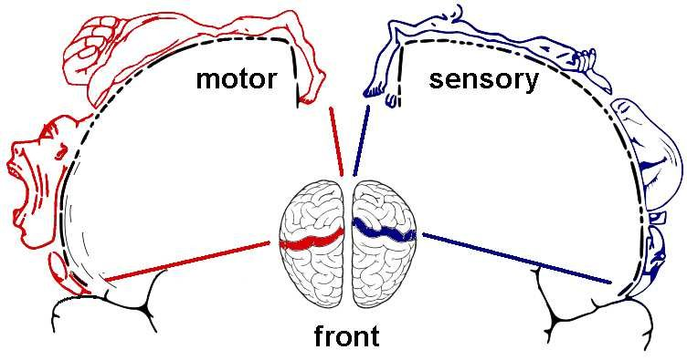
The Neuron
Hebbian Learning
Neuroplasticity

Slide 12
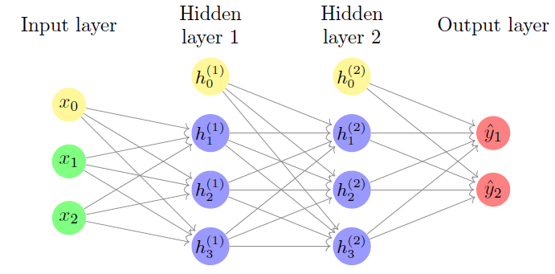
What is exactly a neural network?
An artificial neural network is a machine learning system
inspired by the natural (animal) nervous system, composed
of a set of processing elements, units, or (artificial) neurons
interconnected by weighted connections.

Slide 13
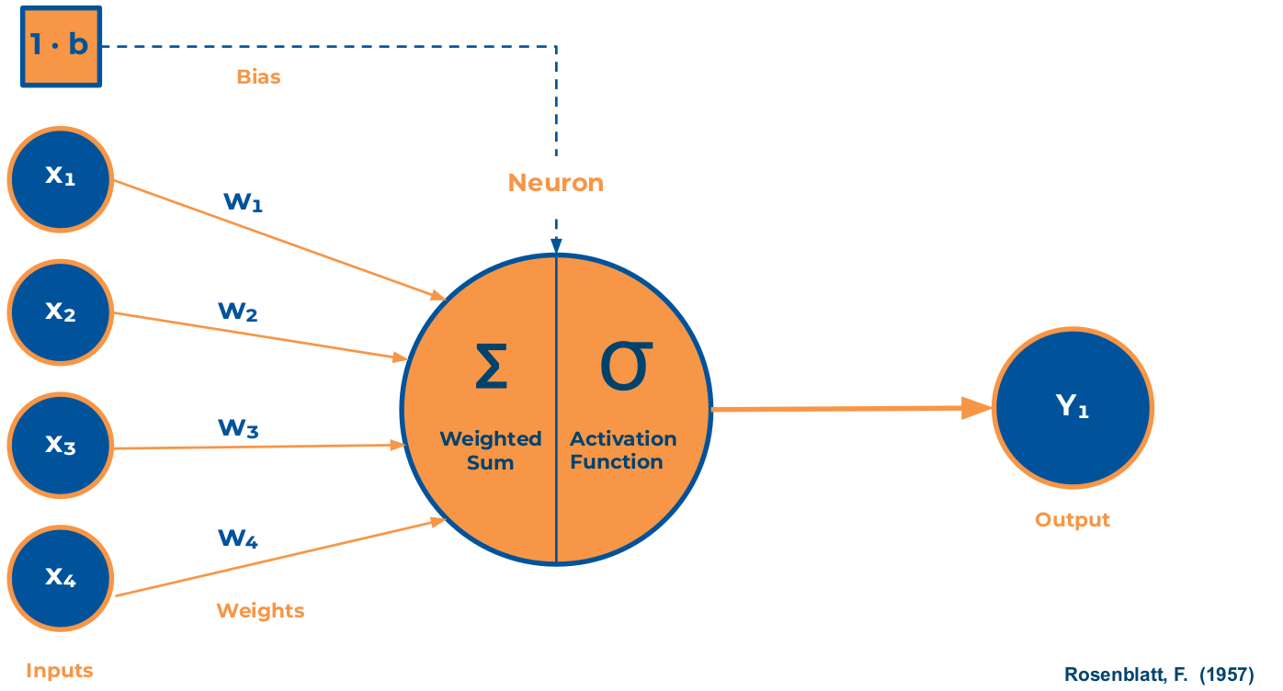

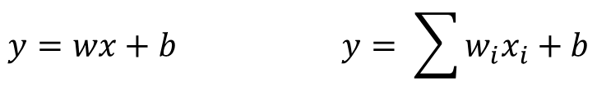
Perceptron

Slide 14
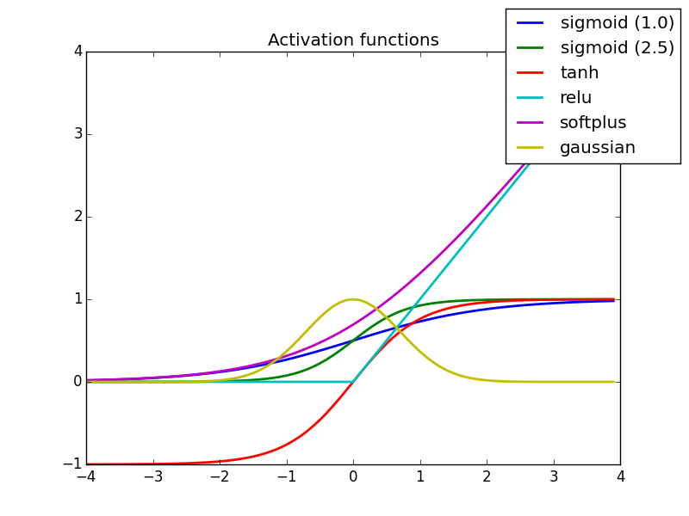
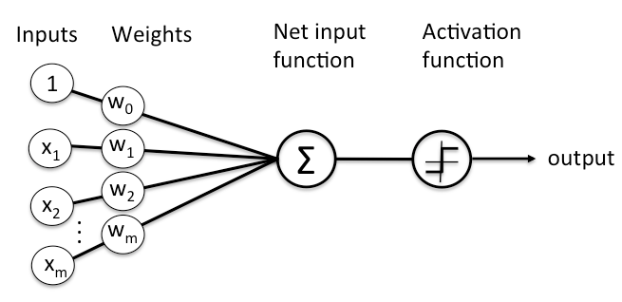
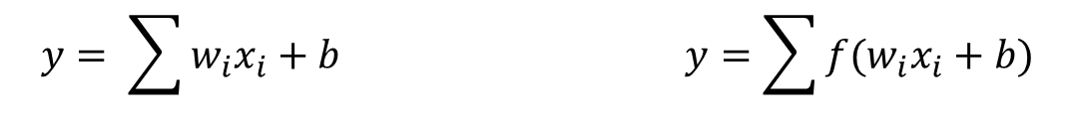
Neurons

Slide 15
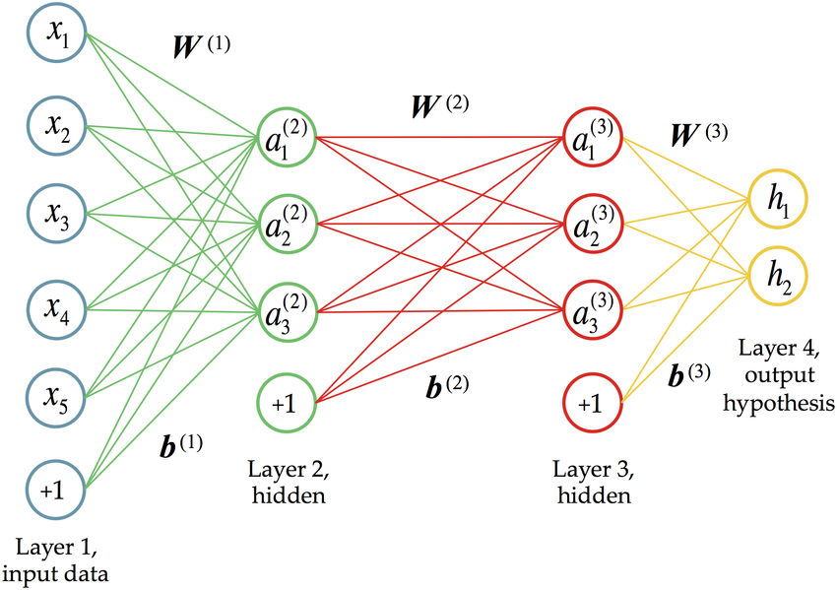
Neural Networks

Slide 16
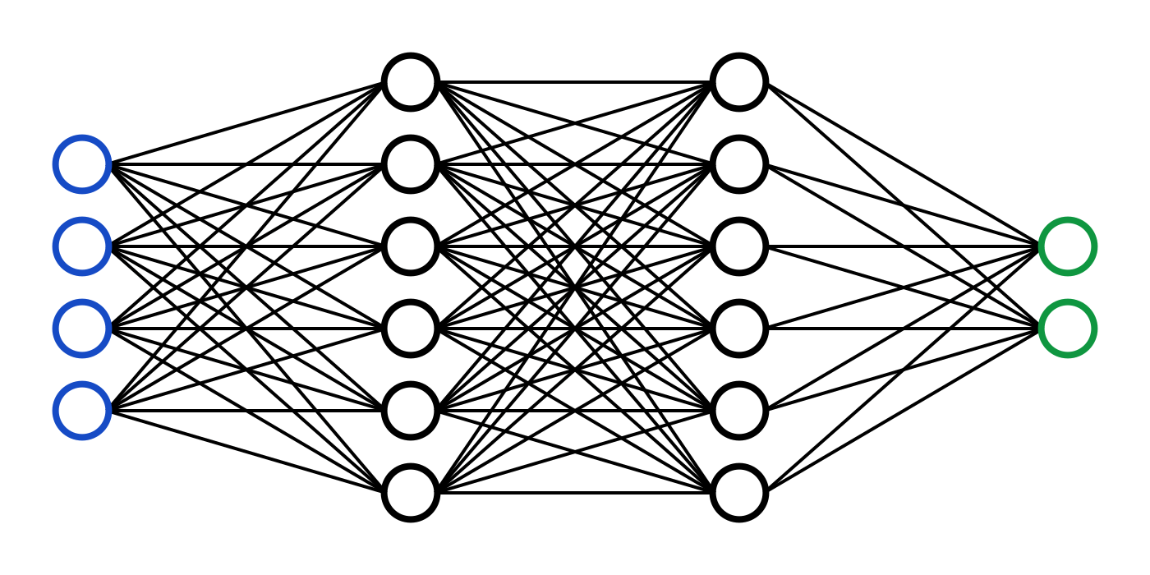
Neural Networks
Lots of data & train time
Subject to overfitting
Universal problem solvers
Importance of weights - backprop

Slide 17
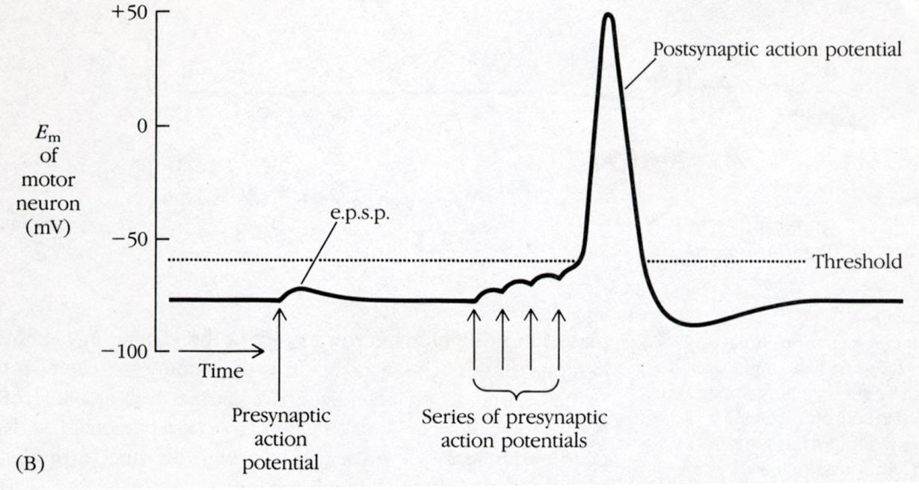
Neural Networks

Slide 18

Know your activation functions: Sigmoid
First one to be used
Costly
Negative values go to zero
Flattens off at the ends – Vanishing gradients

Slide 19
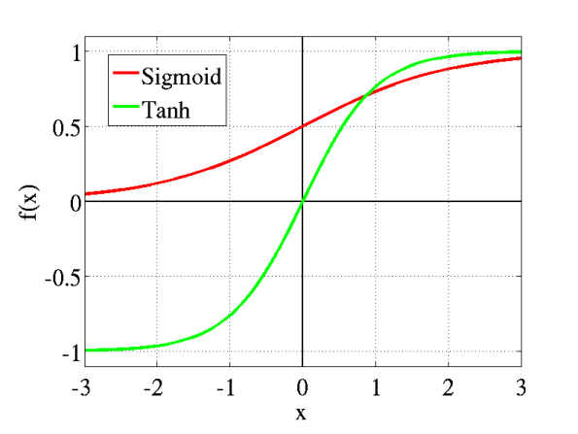
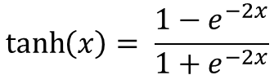
Know your activation functions: Tanh
Negative values are conserved
Zero goes to zero
Still costly
Still flattens

Slide 20
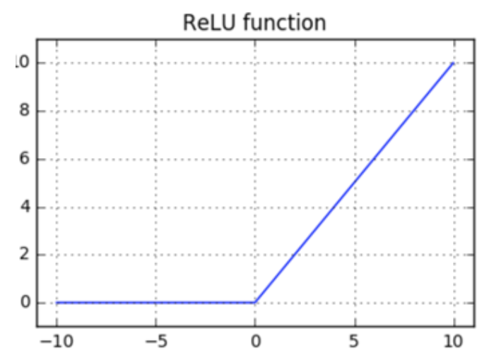
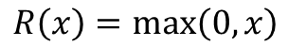
Know your activation functions: ReLU
Cheap!
Big values are not flattened
Negative values go to zero
Negative slope is zero – no learning from negative values

Slide 21
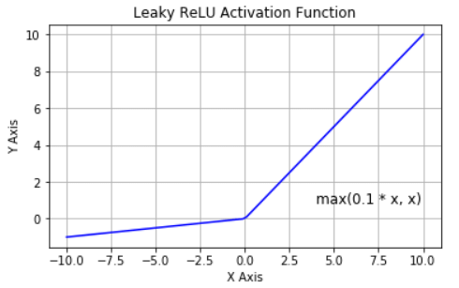

Know your activation functions: Leaky ReLU
Still cheap!
Big values are not flattened
Negative values are conserved
Negative slope is not zero – learning from negative values!

Slide 22
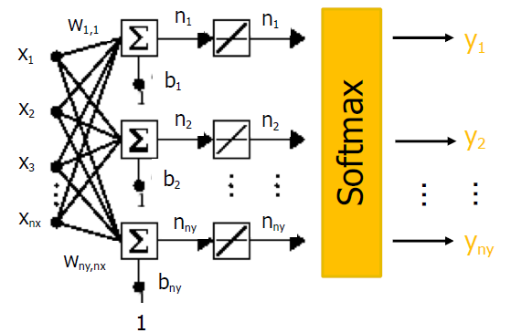

Know your activation functions: softmax
Used at the last layer for categorical prediction
Numerical values to probabilities
Used in conjunction with one-hot encoding

Slide 23
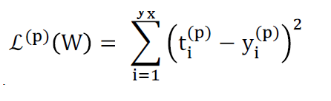
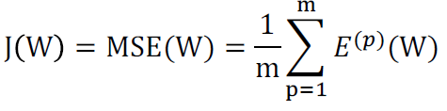
Cost and loss functions
Loss function: Compares the difference between the computed output and the target. E.g: SSE
Cost function: Computes the global error using the whole dataset. E.g: MSE

Slide 24
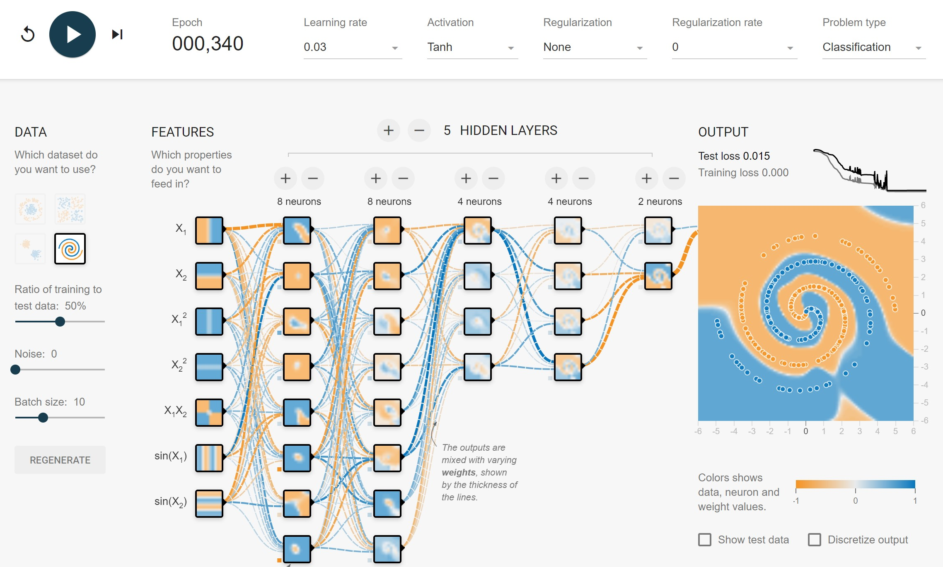
Putting it all together
playground.tensorflow.org

Slide 25
Learning from data – Gradient Descent
¿How do we learn from data?
Gradient descent

Slide 26
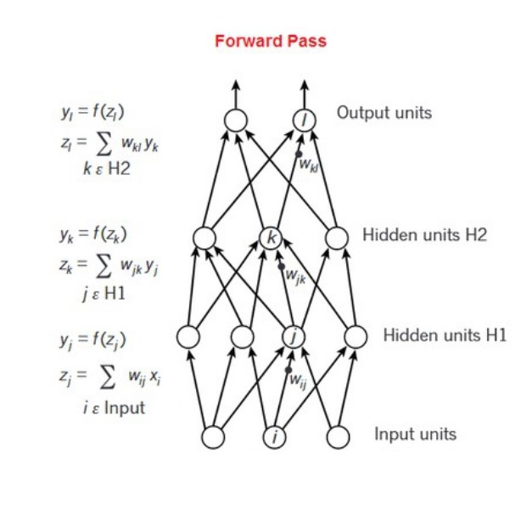
Learning from data – Gradient Descent
Initialize parameters with random numbers
Calculate prediction for training data

Slide 27
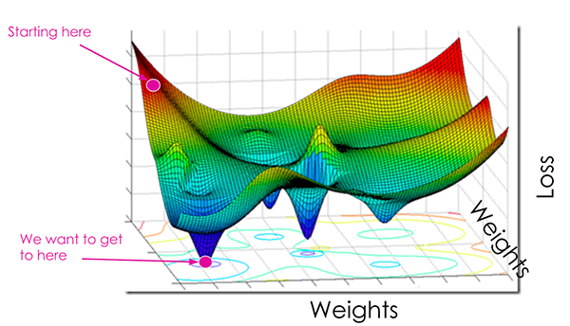
Learning from data – Gradient Descent
3. Calculate cost function
4. Find gradient of cost function

Slide 28

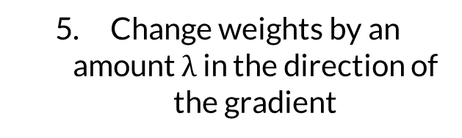
Learning from data – Gradient Descent

Slide 29
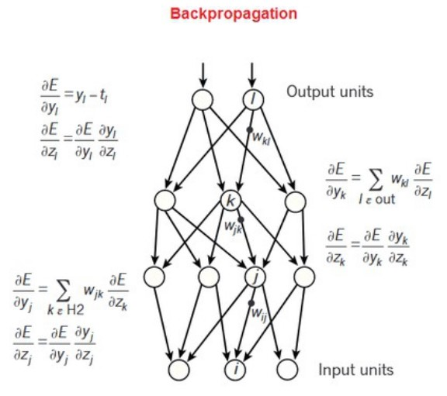
Learning from data – Gradient Descent
6. Propagate the error to previous layers - Backpropagation

Slide 30
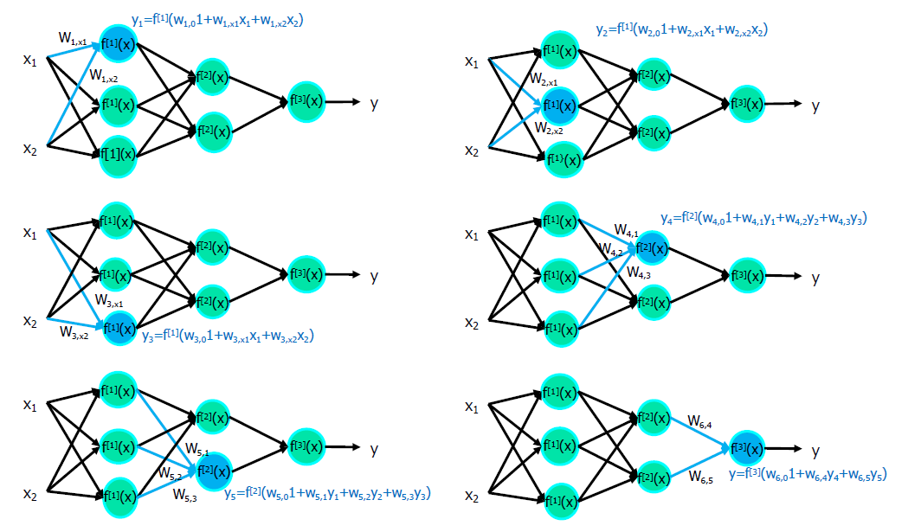
Quick backprop - FeedForward

Slide 31
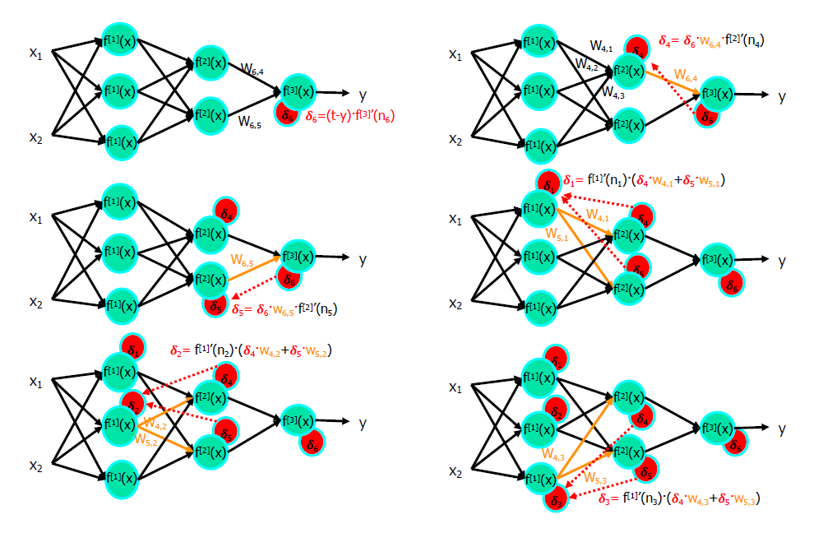
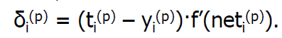
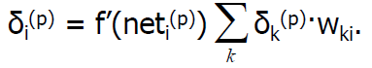
Quick backprop - Gradient Backpropagation

Slide 32
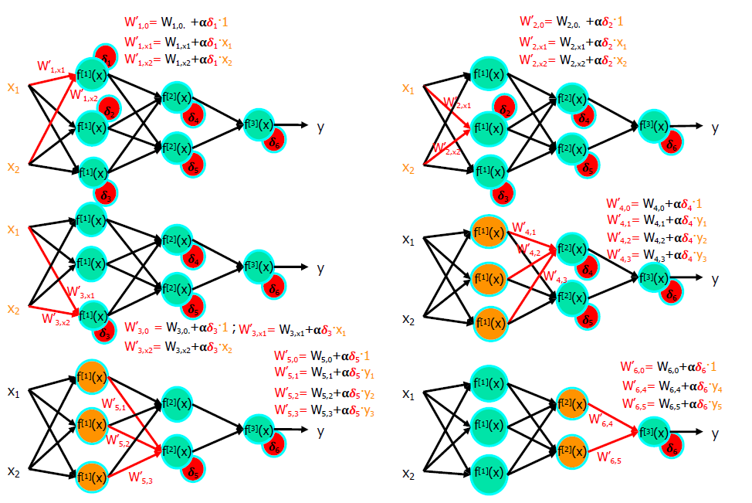
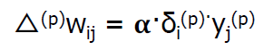
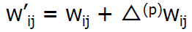
Quick backprop - Weight updates

Slide 33
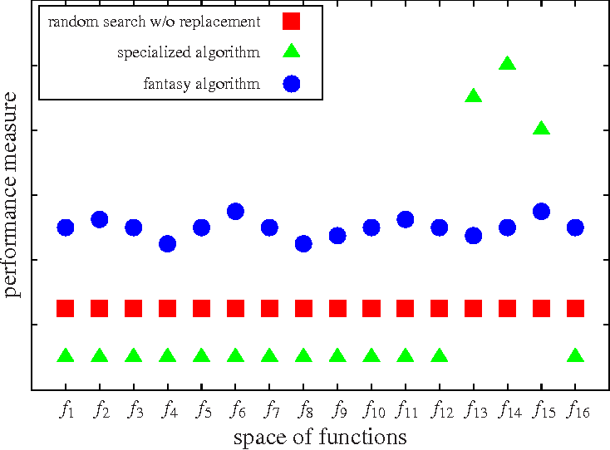
No free lunch theorem
“No model works best for all possible situations”
No “best” architecture for a neural network

Slide 34
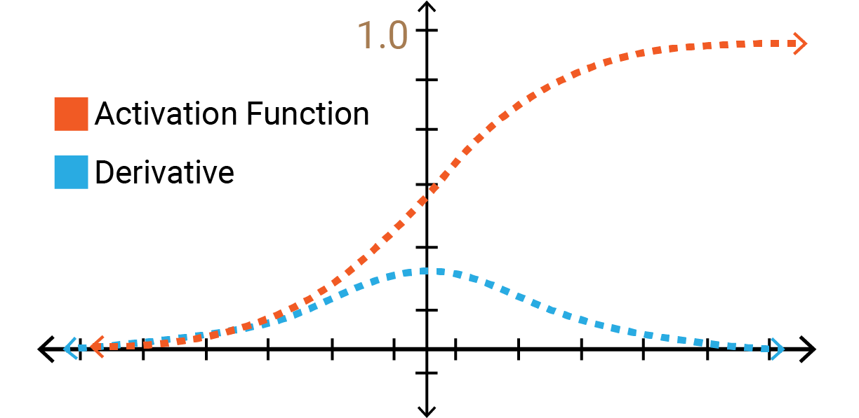
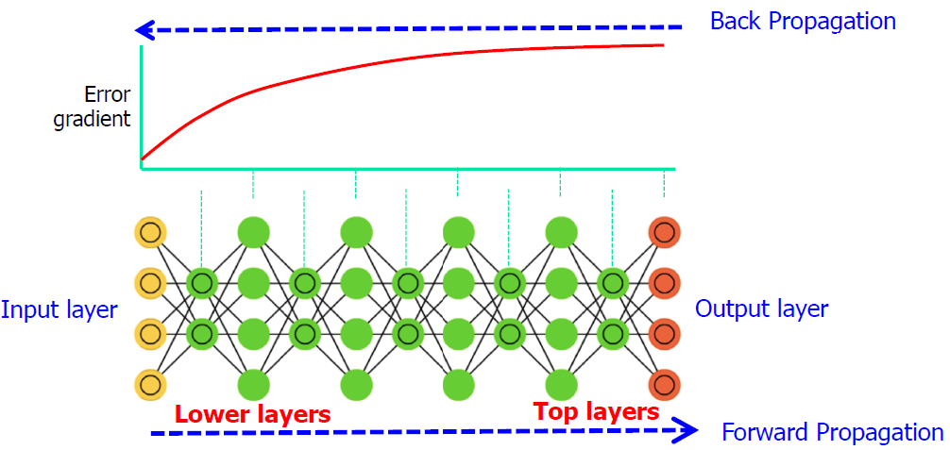
The problem of vanishing gradients
Saturating activation functions have vanishing gradients
Deep networks have trouble learning their initial layers

Slide 35
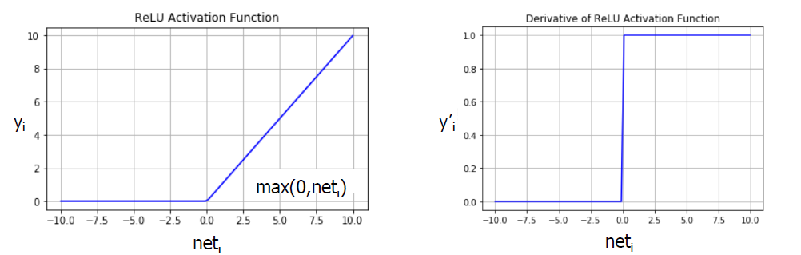
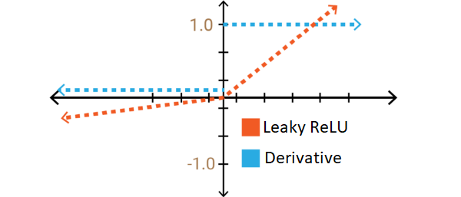
The problem of vanishing gradients
Does not saturate
Very simple
Computationally fast
ReLU

Slide 36
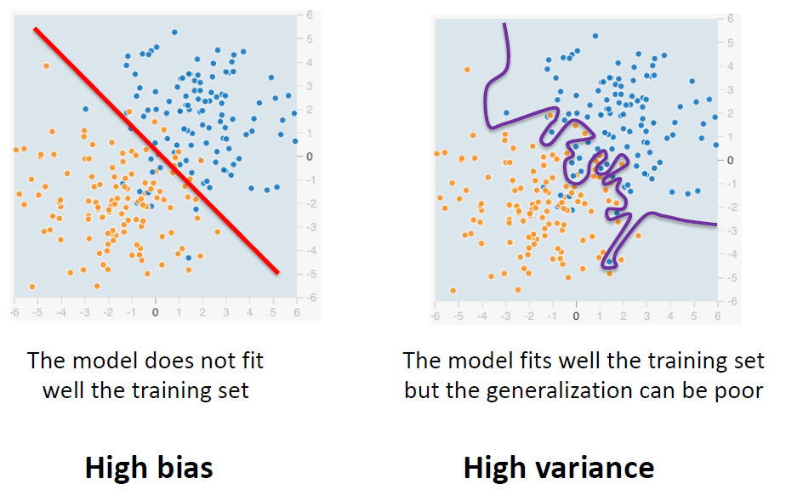
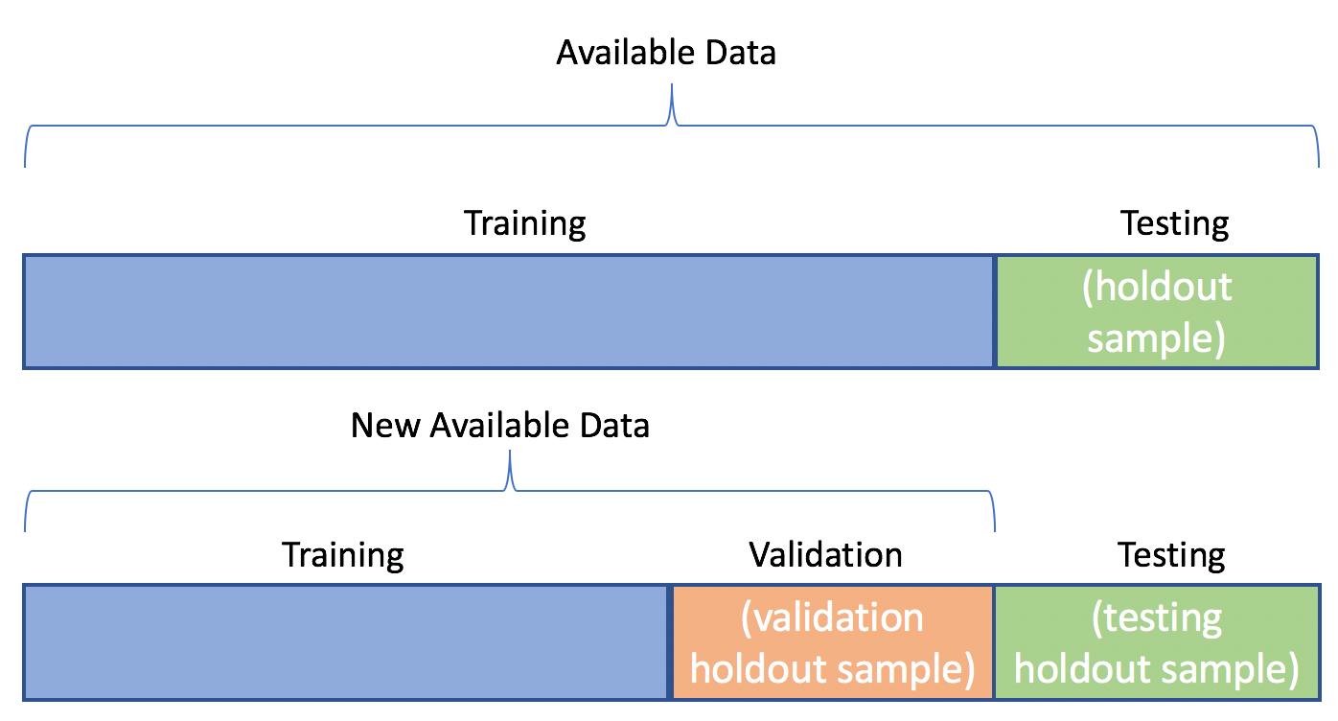
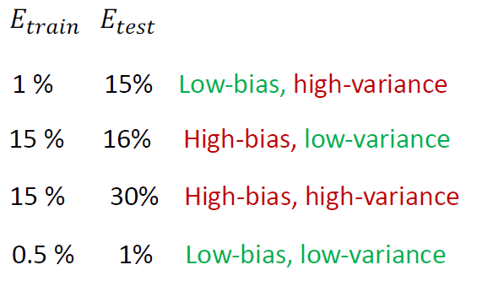
Basic measures

Slide 37
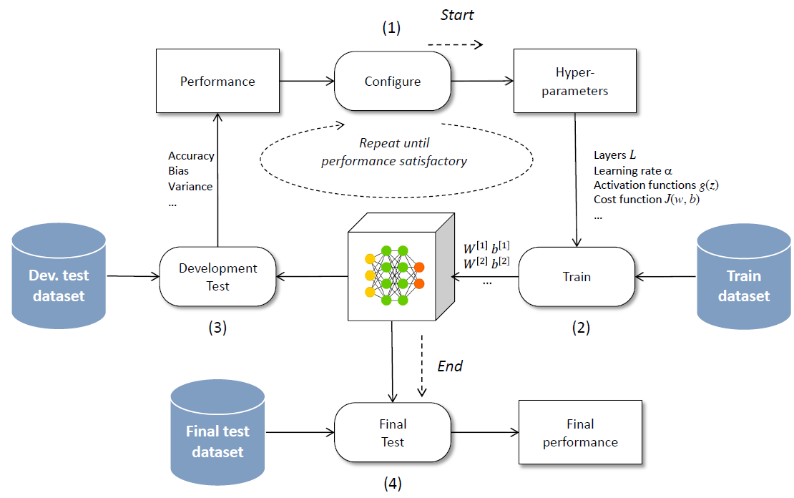
Basic measures

Slide 38
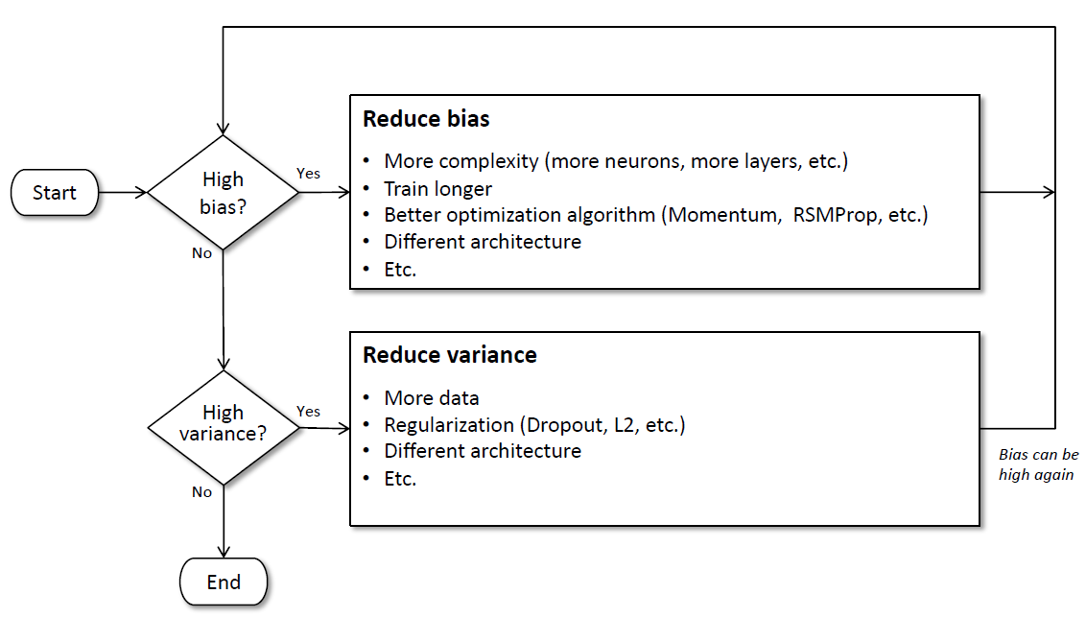
Creation of a neural network

Slide 39
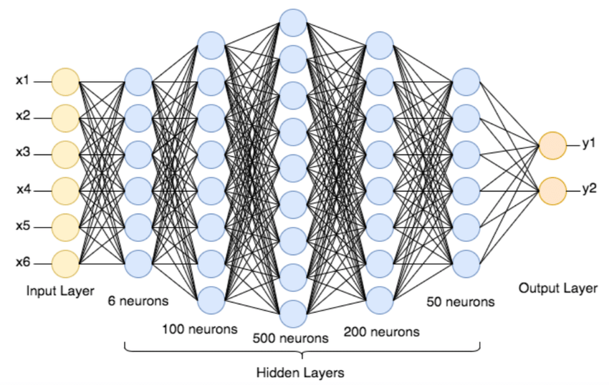
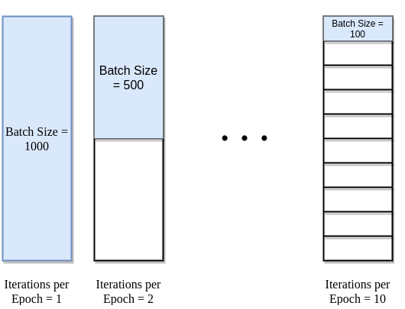
Structure and batch size
https://www.deeplearning.ai/ai-notes/optimization/
Weights can also be initialized
Notes:
Batch gradient descent, stoch, mini

Slide 40
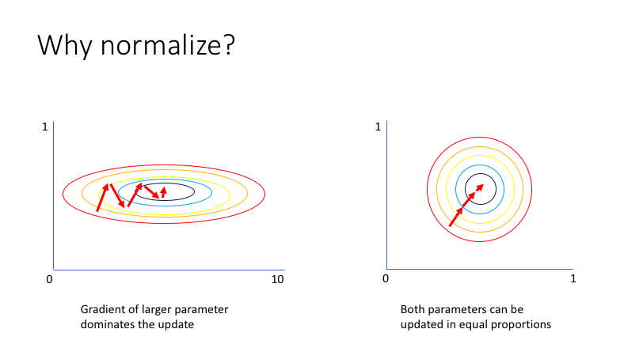

The importance of normalization
Saturated neurons don’t learn
Larger variables dominate learning
Avoid biases

Slide 41

Dropout – learn, don’t memorize
Don’t rely on the same neurons
Only done during training!
Notes:
Random chance of dropping, do not depend on neurons

Slide 42


Early Stopping – learning is overrated
Learning too much
Overfitting!

Slide 43

L1 and L2 Regularization
Overfitting is sometimes attributed to large weights, which occur over time
We can avoid this by keeping our weights small
Notes:
Penalize big weights, absolute value L1 and square value L2

Slide 44


Optimizers: Gradient Descent, but better
https://www.deeplearning.ai/ai-notes/optimization/

Slide 45

Momentum – a rolling ball!
Avoid getting stuck on local minimum
Great for fast learning when slope doesn’t change
Notes:
Accumulate past gradients, good to avoid local minima

Slide 46

Nesterov Accelerated Gradient – Smart momentum
Look ahead for changes in gradient
Slow down at minimums
Notes:
Correct momentum to avoid deviations

Slide 47

Adagrad – better learning rate
Learning rate for each parameter & epoch
Start fast, slow down for minimums
Different learning rates for each parameter – no tuning!

Slide 48
Adadelta – less agressive adagrad
Adagrad with limited diminishing learning rates
Only look at a window of past gradients
Great for sparse data – learn more from rare examples

Slide 49
RMSProp – Root Mean Square Propagation
Adagrad with limited diminishing learning rates
Moving average of square of gradients
Great for more densely packed data
Notes:
If gradient is big in one direction, reduce step in that direction

Slide 50

Adaptive moment estimation – RMSProp + Adadelta
Cheap!
https://www.deeplearning.ai/ai-notes/optimization/
Best of both worlds!
Fast & efficient for all data types

Slide 51

NAdam – Smart momentum + Adam
Smart momentum + adaptive learning rate
Great for noisy cost functions

Slide 52

Transfer learning

Slide 53

Keras Model

Slide 54

Questions?

Slide 55

Challenge!

Slide 56





Bibliografía
/1./ /Hands-on Machine Learning with Scikit-Learn, Keras, and TensorFlow/
/2./ /Fast.AI - Introduction to Machine Learning for Coders/
/3./ /MLCourse.AI/
/4./ /DeltaAnalytics/
/5./ /The Hundred-page Machine Learning Book/
/6./ /Machine Learning for Humans (Vishal Maini)/
/7./ /Datacamp/
/8./ /DataQuest/

